Slide 1
Ensemble Learning
Lecture 08

Slide 2
Why Ensemble?
Scenario 1: You require a new pair of headphones. You would browse a few web technology portals and check the user reviews and would then compare different models that interest you while checking for their features and prices. You will also probably ask your friends and colleagues for their opinion.

Slide 3
Why Ensemble?
Scenario 2: Let’s suppose that you have developed a health and fitness app. Before making it public, you wish to receive critical feedback to close down the potential loopholes, if any. You can resort to one of the following methods, read and decide which method is the best:
You can take the opinion of your spouse or your closest friends.
You can ask a bunch of your friends and office colleagues.
You can launch a beta version of the app and receive feedback from the web development community and non-biased users.

Slide 4
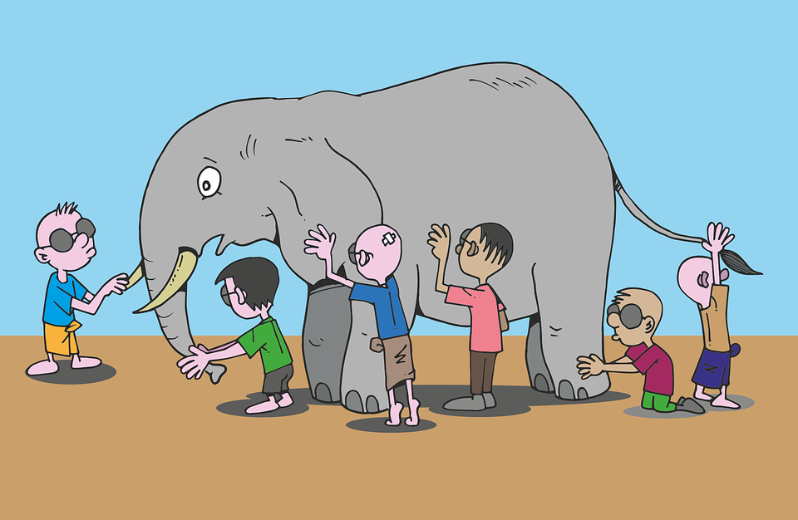
Why Ensemble?
Scenario 3: Take a look at the following picture; we can see a group of blindfolded children playing the game of “Touch and tell” while examining an elephant which none of them had ever seen before. Each of them will have a different version as to how does an elephant looks like because each of them is exposed to a different part of the elephant. Now, if we give them a task of submitting a report on elephant description, their individual reports will be able to describe only one part accurately as per their experience but collectively they can combine their observations to give a very accurate report on the description of an elephant.

Slide 5
What is an Ensemble Method?
Ensemble models in machine learning combine the decisions from multiple models to improve the overall performance.
They operate on the similar idea as employed while buying headphones, getting feedback of newly developed fitness app and blindfolded game.
Ensembles are a divide and conquer approach used to improve performance.

Slide 6
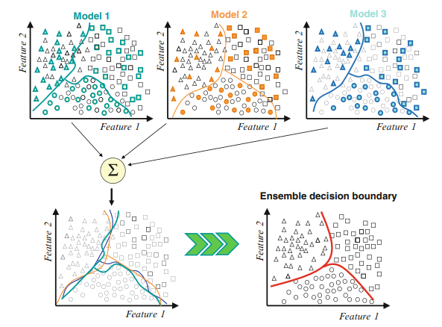
A Classifier Ensemble

Slide 7
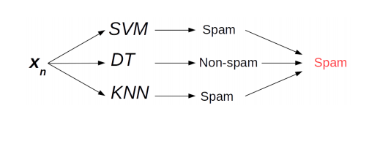
Simple Ensemble techniques
Taking the mode of the results
In this technique, multiple models are used to make predictions for each data point. The predictions by each model are considered as a separate vote. The prediction which we get from the majority of the models is used as the final prediction.

Slide 8
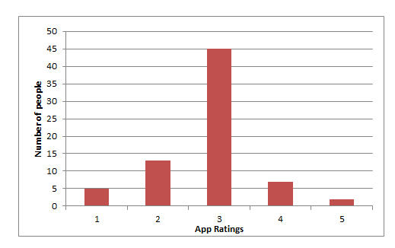
Simple Ensemble techniques
Taking the average of the results
In this technique, we take an average of predictions from all the models and use it to make the final prediction.
AVERAGE= sum(Rating*Number of people)/Total number of people= (1*5)+(2*13)+(3*45)+(4*7)+(5*2)/72 = 2.833 =Rounded to nearest integer would be 3
Scenario 2: ratings of beta version of our fitness app got from the user community. (Consider each person as a different model)

Slide 9
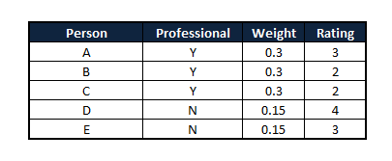
Simple Ensemble techniques
Taking weighted average of the results
This is an extension of the averaging method. All models are assigned different weights defining the importance of each model for prediction.
For instance, if about 25 of your responders are professional app developers, while others have no prior experience in this field, then the answers by these 25 people are given more importance as compared to the other people.
For example:
For posterity, I am trimming down the scale of the example to 5 people
WEIGHTED AVERAGE= (0.3*3)+(0.3*2)+(0.3*2)+(0.15*4)+(0.15*3) =3.15 = rounded to nearest integer would give us 3

Slide 10
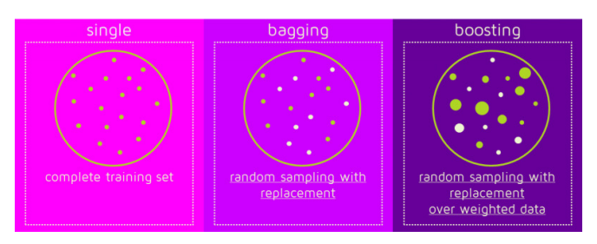
Advanced Ensemble techniques
Instead of training different models on same data, train same model multiple times on different data sets, and “combine” these “different” models
We can use some simple/weak model as the base model
How do we get multiple training data sets (in practice, we only have one data set at training time)?

Slide 11

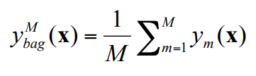
Bagging
Bagging stands for Bootstrap Aggregation (Breiman 1994)
Simple idea: generate M bootstrap samples from your original training set. Train on each one to get and average them
For Regression: average predictions
For Classification: average class probabilities (or take the majority vote if only hard outputs available)
Bagging approximates the Bayesian posterior mean. The more bootstraps the better, so use as many as you have time for.
Each bootstrap sample is drawn with replacement, so each one contains some duplicates of certain training points and leaves out other training points completely

Slide 12
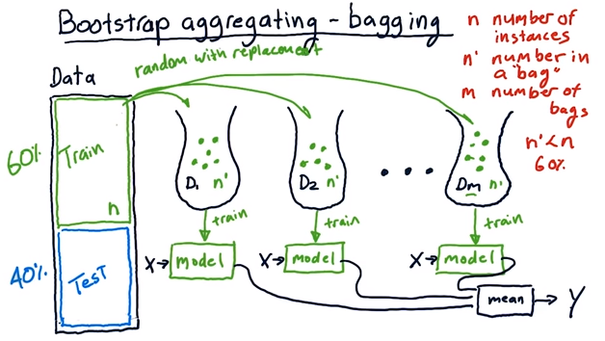

Slide 13
Why does bagging work?
Bagging reduces variance by voting/ averaging, thus reducing the overall expected error
In the case of classification there are pathological situations where the overall error might increase e.g. Small dataset, Biased base models, etc.
Usually, the more classifiers the better

Slide 14
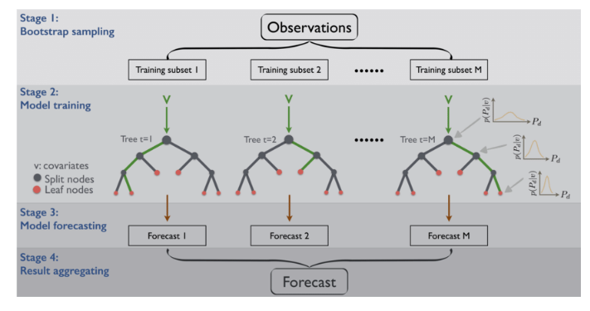
Random Forests
Random forest technique actually uses this concept but it goes a step ahead to further reduce the variance by randomly choosing a subset of features as well for each bootstrapped sample to make the splits while training

Slide 15
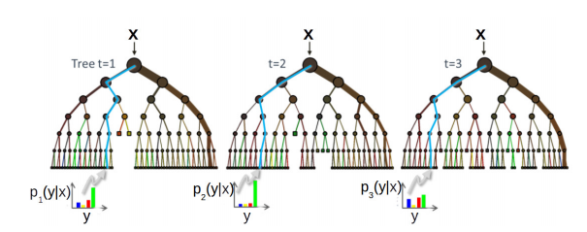
Random Forest Algorithm
An ensemble of decision tree (DT) classifiers
Uses bagging on features (each DT will use a random set of features)
Given a total of D features, each DT uses √ D randomly chosen features
Randomly chosen features make the different trees uncorrelated
All DTs usually have the same depth
Each DT will split the training data differently at the leaves
Prediction for a test example votes on/averages predictions from all the DTs

Slide 16
Randomization Injection
Inject some randomization into a standard learning algorithm (usually easy):
Neural network: random initial weights
Decision tree: when splitting, choose one of the top N attributes at random (uniformly)
Dietterich (2000) showed that 200 randomized trees are statistically significantly better than C4.5 for over 33 datasets!

Slide 17
Feature-Selection Ensembles
Key idea: Provide a different subset of the input features in each call of the learning algorithm.
Example: Venus&Cherkauer (1996) trained an ensemble with 32 neural networks. The 32 networks were based on 8 different subsets of 119 available features and 4 different algorithms. The ensemble was significantly better than any of the neural networks!

Slide 18
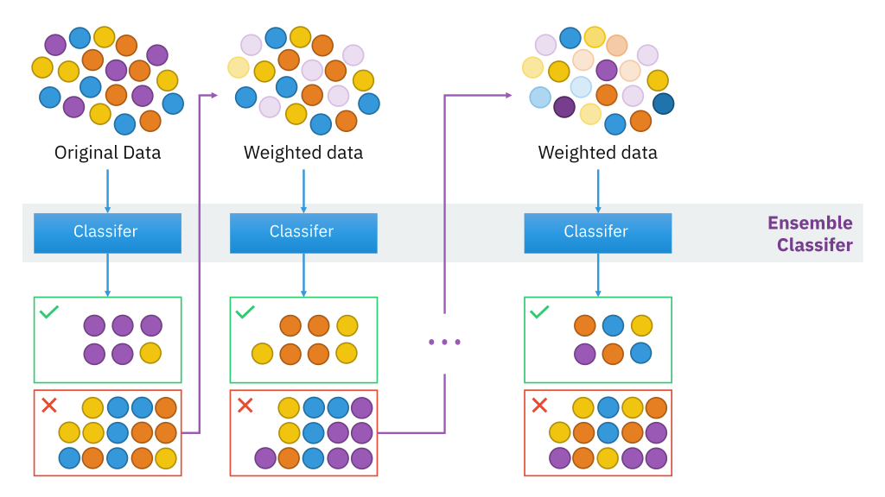
Boosting

Slide 19
Boosting
It focuses on classification problems and aims to convert a set of weak classifiers into a strong one.
Many popular algorithms have been proposed and used in industries.
Three most popular boosting algorithms are: AdaBoost, GBM and XGBoost.
The AdaBoost, short for “Adaptive Boosting”, is the first practical boosting algorithm proposed by Freund and Schapire in 1996.

Slide 20
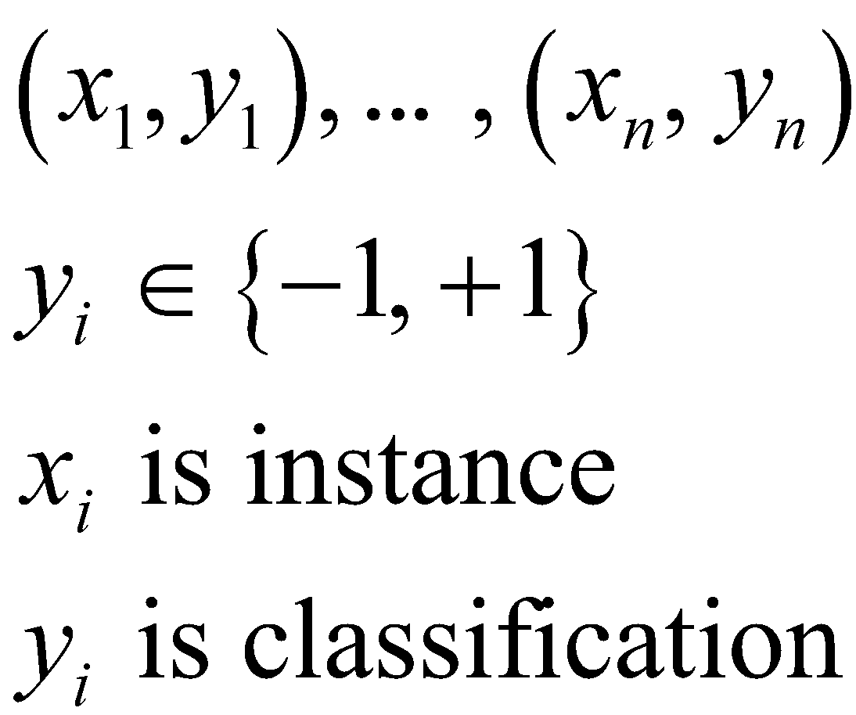
CLASSIFICATION: AdaBoost Algorithm
Given training data

Slide 21
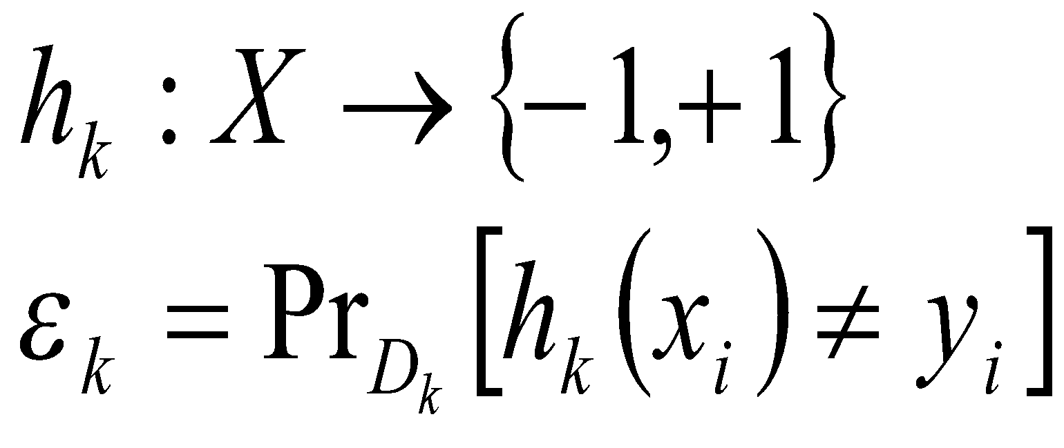
CLASSIFICATION: AdaBoost Algorithm
For k = 1, …, K
Create distribution D_{k} on {1, …, n}
Select weak classifier with smallest error on D_{k}
Output single final classifier

Slide 22
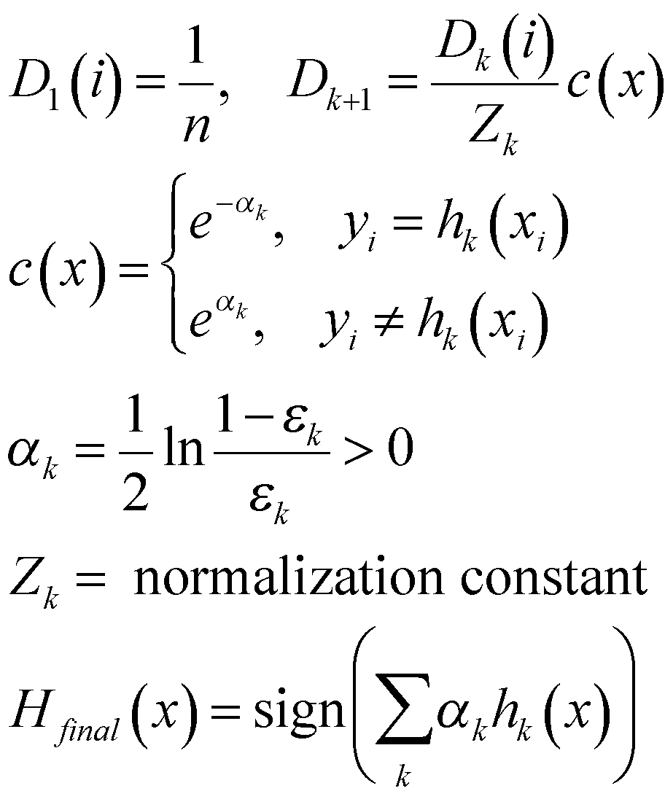
CLASSIFICATION: AdaBoost Algorithm
Constructing D_{k}

Slide 23
CLASSIFICATION: AdaBoost Example
Training data:
Index | 0 | 1 | 2 | 3 | 4 | 5 | 6 | 7 | 8 | 9
X value | 0 | 1 | 2 | 3 | 4 | 5 | 6 | 7 | 8 | 9
Y value | 1 | 1 | 1 | -1 | -1 | -1 | 1 | 1 | 1 | -1

Slide 24
CLASSIFICATION: AdaBoost Example
Weak learner:
Hypotheses of form x < T or x > T.
Threshold T to be determined so as to minimize the probability of error over the entire data.
Start with following probabilities for k = 1:
p₀ | p₁ | p₂ | p₃ | p₄ | p₅ | p₆ | p₇ | p₈ | p₉
0.1 | 0.1 | 0.1 | 0.1 | 0.1 | 0.1 | 0.1 | 0.1 | 0.1 | 0.1

Slide 25
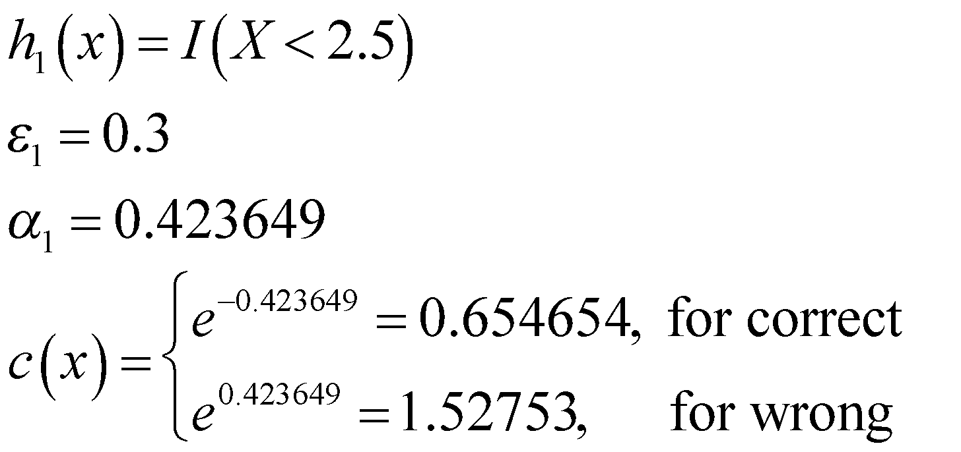
CLASSIFICATION: AdaBoost Example
Best threshold is between 2 and 3 – ie

Slide 26
CLASSIFICATION: AdaBoost Example
Update the probabilities
Index | 0 | 1 | 2 | 3 | 4 | 5 | 6 | 7 | 8 | 9
Correct | Y | Y | Y | Y | Y | Y | N | N | N | Y
Old p_{i} | .1 | .1 | .1 | .1 | .1 | .1 | .1 | .1 | .1 | .1
Pre-norm p_{i} | .066 | .066 | .066 | .066 | .066 | .066 | .15 | .15 | .15 | .066
Z₁ =0.916515
New p_{i} | .071 | .071 | .071 | .071 | .071 | .071 | .17 | .17 | .17 | .071

Slide 27
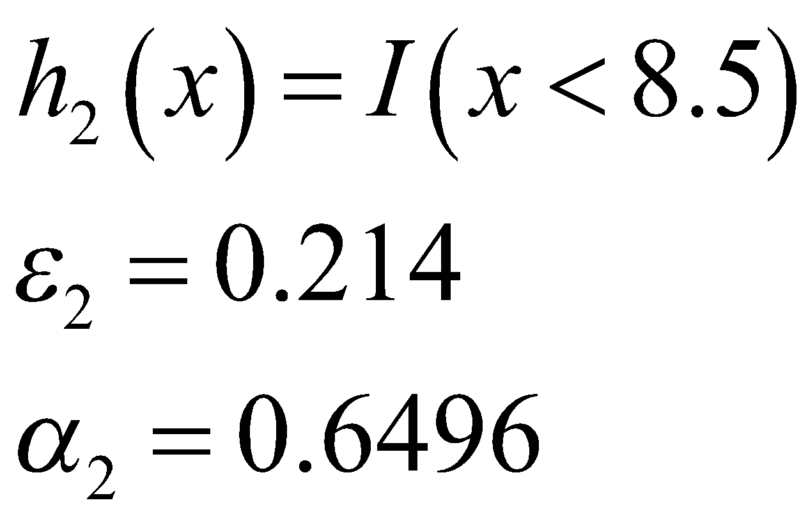
CLASSIFICATION: AdaBoost Example
k = 2.
Now a threshold between 2 and 3 results in error of 0.5, but between 5 and 6 gives error of 0.28 and between 8 and 9 gives 0.214

Slide 28
CLASSIFICATION: AdaBoost Example
Update the probabilities
Index | 0 | 1 | 2 | 3 | 4 | 5 | 6 | 7 | 8 | 9
Correct | Y | Y | Y | N | N | N | Y | Y | Y | Y
Pre-norm p_{i} | .037 | .037 | .037 | .137 | .137 | .137 | .087 | .087 | .087 | .037
Z₁=.82
New p_{i} | .045 | .045 | .045 | .167 | .167 | .167 | .106 | .106 | .106 | .045

Slide 29
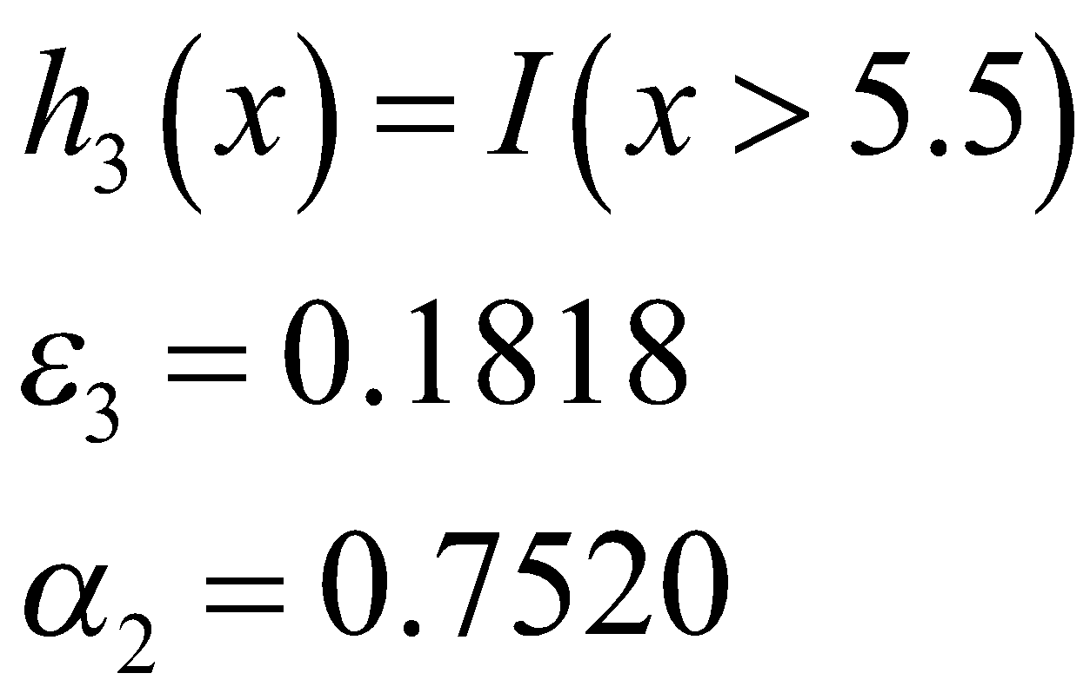
CLASSIFICATION: AdaBoost Example
3 mistakes
k = 3.
Best threshold between 5 and 6

Slide 30
CLASSIFICATION: AdaBoost Example
Update the probabilities
Index | 0 | 1 | 2 | 3 | 4 | 5 | 6 | 7 | 8 | 9
Correct | N | N | N | Y | Y | Y | Y | Y | Y | Y
Pre-norm p_{i} | .096 | .096 | .096 | .078 | .078 | .078 | .05 | .05 | .05 | .096
Z₁=.77
New p_{i} | .125 | .125 | .125 | .102 | .102 | .102 | .064 | .064 | .064 | .125

Slide 31
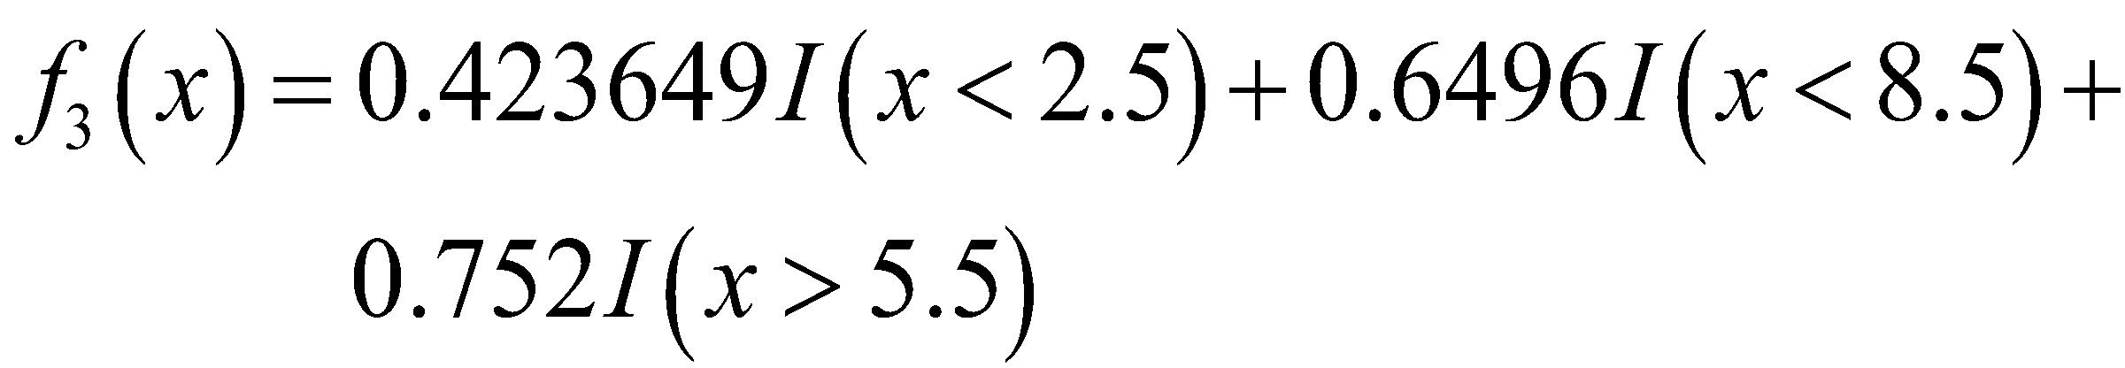
CLASSIFICATION: AdaBoost Example
0 mistakes

Slide 32
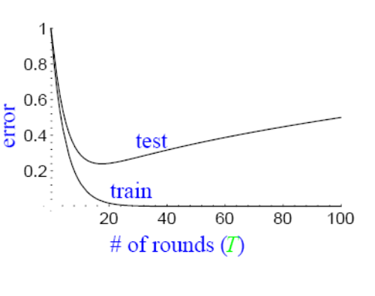
How might test error react to AdaBoost?
We expect to encounter:
Occam’s Razor
Overfitting

Slide 33
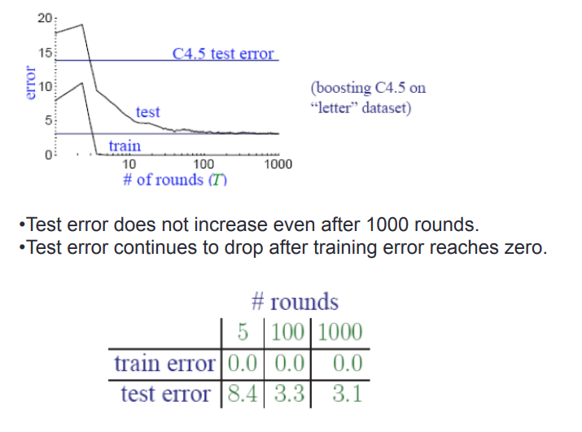
Empirical results of test error

Slide 34
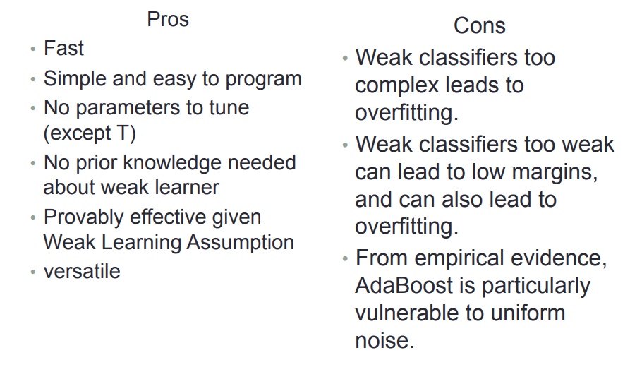
Pros/Cons of AdaBoost

Slide 35
Gradient Boosting
In this method we try to visualise the boosting problem as an optimisation problem, i.e we take up a loss function and try to optimise it.
Gradient boosting involves three elements:
A loss function to be optimized.
A weak learner to make predictions.
An additive model to add weak learners to minimize the loss function.

Slide 36
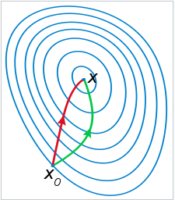
XGBoost(Extreme Gradient Boosting)
XGBoost is similar to gradient boosting algorithm but it has a few tricks up its sleeve which makes it stand out from the rest.
Features of XGBoost are:
Clever Penalisation of Trees
A Proportional shrinking of leaf nodes
Newton Boosting (uses curvature information (i.e. the
second derivative) to take a more direct route.)
Extra Randomisation Parameter (The extra randomisation parameter can be used to reduce the correlation between the trees, as seen in the previous article, the lesser the correlation among classifiers, the better our ensemble of classifiers will turn out.)

Slide 37
Stacking
Uses meta learner instead of voting to combine predictions of base learners
Predictions of base learners (level-0 models) are used as input for meta learner (level-1 model)
Base learners usually different learning schemes
Hard to analyze theoretically: “black magic”

Slide 38
Some Practical Advices
If the classifier is unstable (high variance), then apply bagging!
If the classifier is stable and simple (high bias) then apply boosting!
If the classifier is stable and complex then apply randomization injection!
If you have many classes and a binary classifier then try error-correcting codes! If it does not work then use a complex binary classifier!

Slide 39
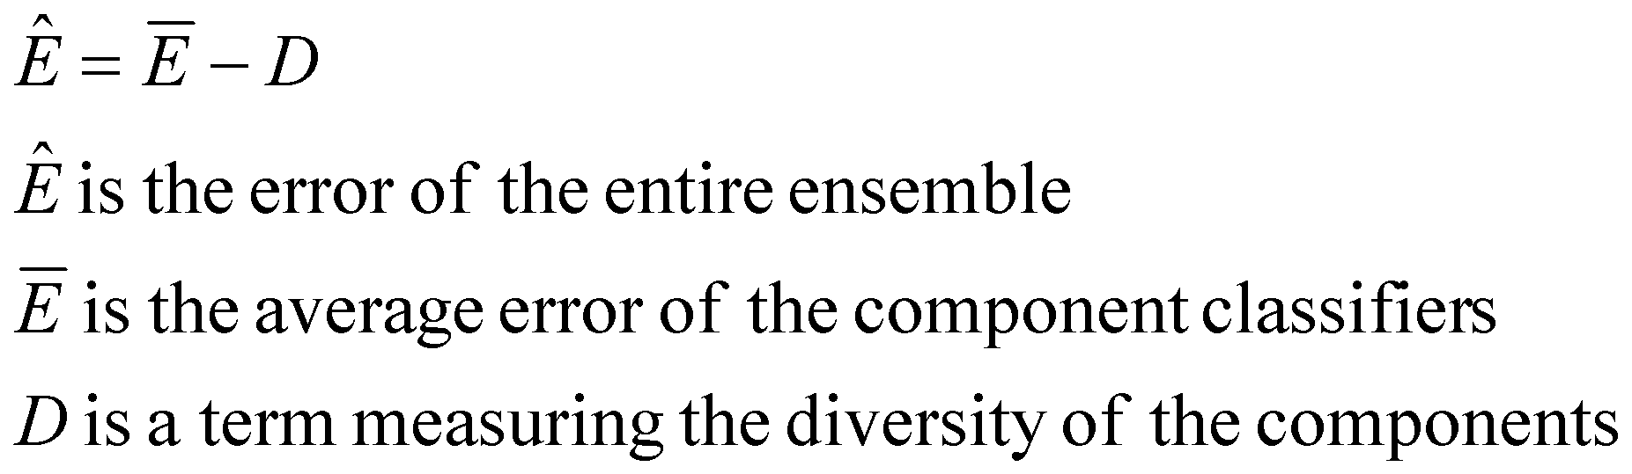
What Makes a Good Ensemble?
Krogh and Vedelsby, 1995
Can show that the accuracy of an ensemble is mathematically related:
Effective ensembles have accurate and diverse components

Slide 40
Diversity Measures
Most Popular
Plain Disagreement Measure
Entropy

Slide 41
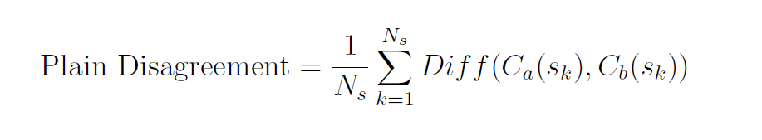


For two classifiers a and b
For two classifiers a and b
is the number of Samples in the dataset
is the class assigned by classifier i to sample k
Diff(x,y) = 0 if x = y otherwise 1

Slide 42

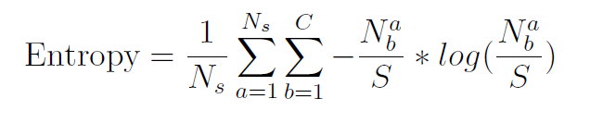
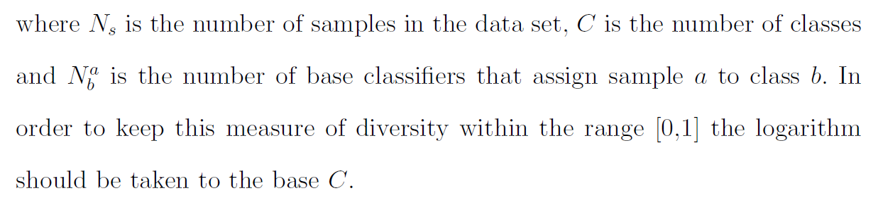

Slide 43
References
“Ensemble Machine Learning Methods and Applications” by Cha Zhang & Yunqian Ma
Introduction to Data Mining by Tan, Steinbach, Kumar (Lecture Slides)
‎Kim Ho et al Hybrid Schemes Of Homogeneous And Heterogeneous Classifiers For Cursive Word Recognition, 2000
L. Xu, A. Krzyzak, and C. Y. Suen. Methods for combining multiple classifiers and their applications to handwriting recognition. IEEE transactions on SMC, 23(3):418–435, 1992
Ludmila I. Kuncheva (2004). Combining Pattern Classifiers: Methods and Algorithms. John Wiley and Sons, Inc..
J. Kittler, M. Hatef, Robert P.W. Duin, J. Matas (1998). On combining classifiers. IEEE Transactions on Pattern Analysis and Machine Intelligence. 20(3):226-239.
Evgueni Smirnov, Lecture Notes on Ensemble of Classifiers
https://towardsdatascience.com/simple-guide-for-ensemble-learning-methods-d87cc68705a2
https://cse.iitk.ac.in/users/piyush/courses/ml_autumn16/771A_lec21_slides.pdf

